Slide 1
Introduction to PyXRF and XMIDAS Tools At NSLS-II
Ajith Pattammattel
Aug 01, 2022
Notes:
Time ? 1 hr
Audience? Students, users, industry , some efforts in other data structures, get some idea about abs. correction. Ming
Installation?
Plan b in case of crash
Get a data from another beamline
Make interesting with sample , different types

Slide 2
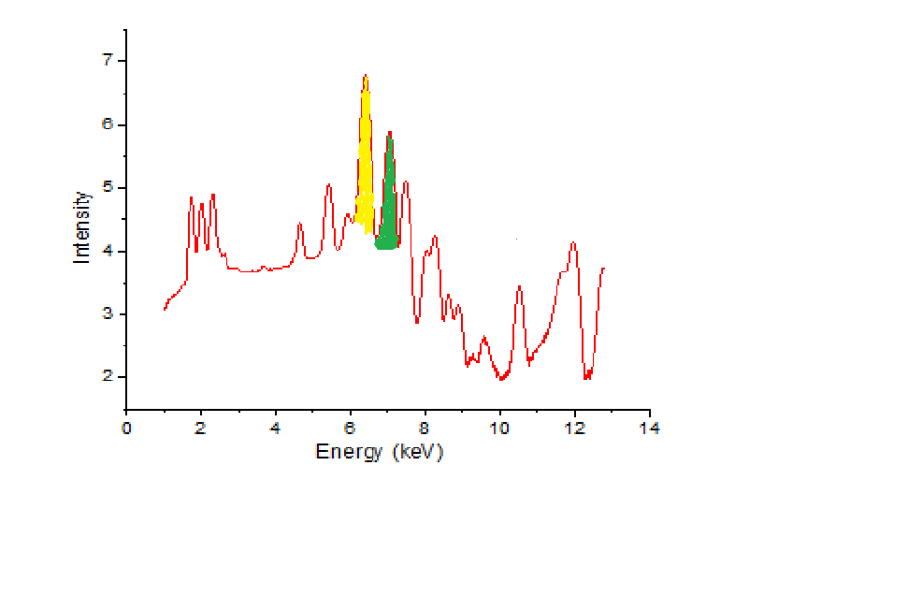
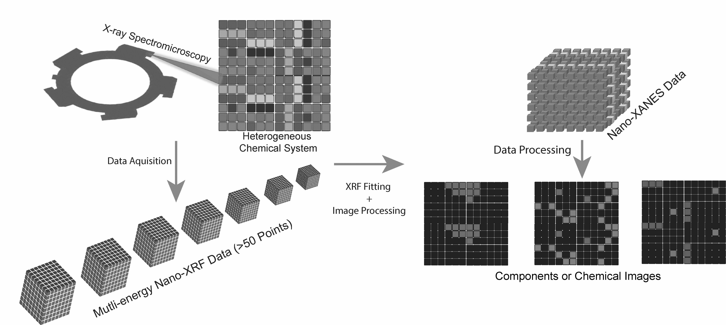
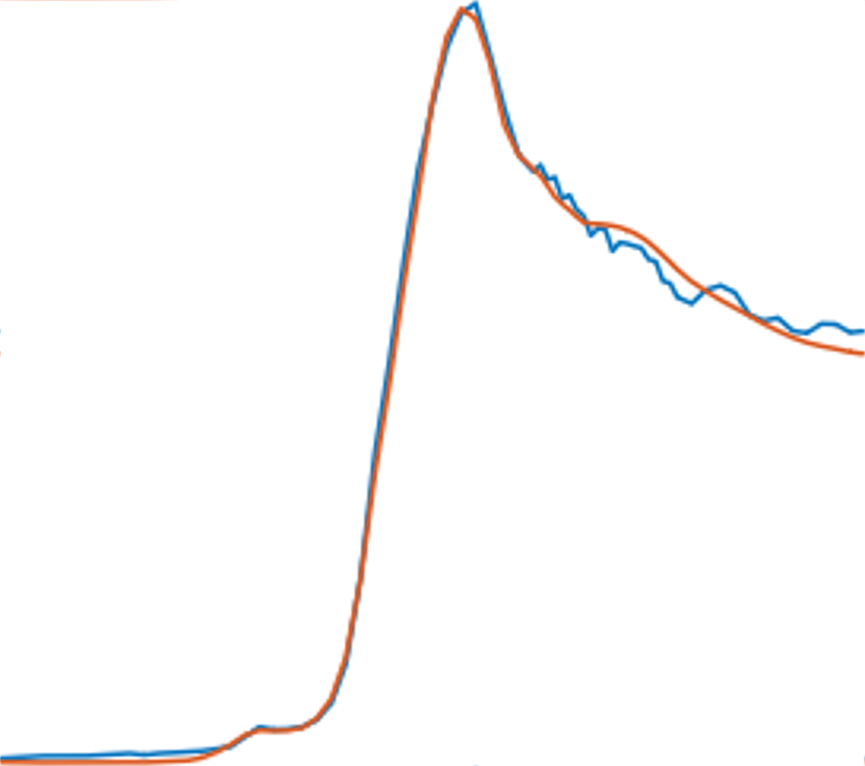
X-Ray Scanning Probe Spectromicroscopy
XRF
Raster Scans
Spectrum Fitting
LC-Fitting
XANES
Intensity
Elemental Maps
or
Chemical state Maps
Photon Energy
Notes:
Each pixel has a spectrum
Fit the spectrum to get elemental or chemical map

Slide 3
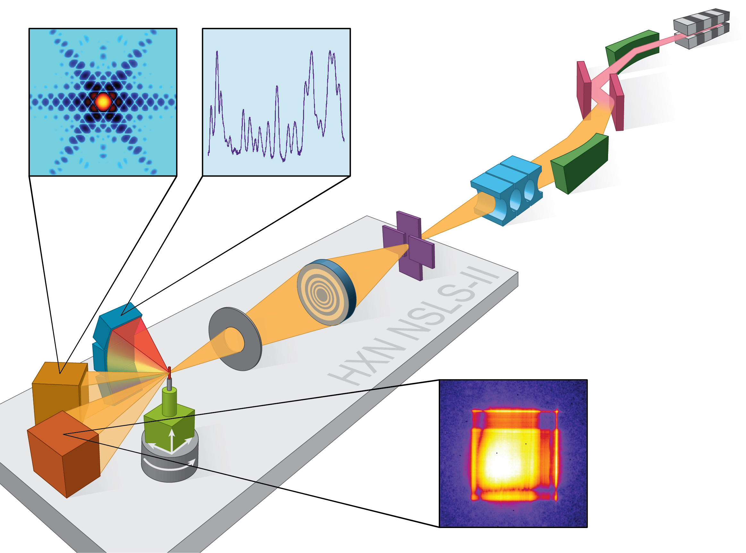
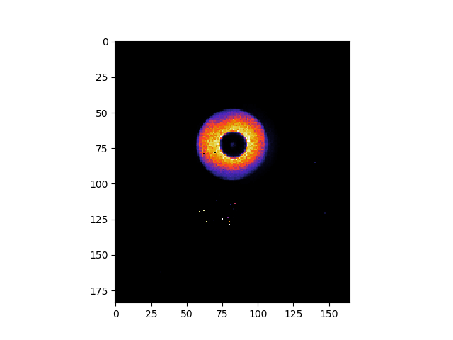
Hard X-ray Nanoprobe Beamline (HXN) @ NSLS2
Imaging and Microscopy Group @ NSLS-II
Hard X-ray Nanoprobe (HXN)
Submicron Resolution X-ray Spectroscopy (SRX)
X-ray Fluorescence Microprobe (XFM)
Tender Energy X-ray Absorption Spectroscopy (TES)
Full Field X-ray Imaging (FXI)
Resolution: >10 nm
Energy Range: 6-20 keV
Flux: 10⁹ ⁻ 10⁹ ph/s
He-environment or Vacuum, RT
Notes:
Slide 10. At HXN beamline sub-10 nm XRF maps were demonstrated previously. And the sample and beam stability was well established. But these experiments were collected at fixed energy point. Therefore, to establish nano-XANES beamline has to be studied and optimized to assure a continues energy change without compromising the probe size, beam&sample position, and flux. The reason for continues energy change was not straightforward at HXN was due to the chromatic optics, CRL and Zone plate, those focus conditions change with energy. So most of initial work was dedicated to investigate the quality and reliability of the xanes. Here is a schematic representation of how nano-XANES data is collected. We collect nano-XRF maps at several energy points over the absorption edge of the atom, which would result in an energy stack, where the XY are the sample coordinates and the Z direction is energy. This way you have a XANES spectrum at each pixel in the image. The XANES spectrum at each pixel cn be fitted to generate so-called chemical state maps and the reliability of the maps are depend on hoe well one can do the energy change without compromising the focus, flux and position.

Slide 4
Nano-XRF to Nano-XANES Analysis Workflow
PyXRF
XMIDAS
Aq. Time 5-20 hrs
Notes:
Slide 25. First part of the workflow integration was to find the optics component positions for each energy point, then we collect 2D XRF maps. At the beamline we record the list of scan numbers for the series. After the experiment is done one has to take all the data from the data broker and fit using pyXRF. For this I intially created a rough workflow and collaborated with Dmitri, he created a well-defined worflow to add this to PyXRF API. But there was no program suitable to examine nano-XANES data this intial examination. But there are programs made for TXM and STXM workflows, which can be used to analyze this data in parts. Therefor we decided to create software package named NSLS-II MIDAS.I will talk about each of these steps next. (Do everything in one place, help well with collaboration)

Slide 5
PyXRF Demo
Model Sample for Analysis
Data type
Peak Assignment;
Find / choose elements
Escape peaks
Custom Peaks
Initial fit
Optimizing the fit → Best fit
Elemental Maps
RGB Maps
Export Data
Batch & Live Fitting (Currently available only at the Beamline)

Slide 6
Summary of XMIDAS
MANTIS
AXIS 2000
STXMPy
…
Interactive GUI for All User level
Connection to existing programs
Supports Multimodality
Tiff + H5 Data from IMP beamlines + APS-MAPS
TXM Wizard
TXM Sandbox
PyXAS
…
Notes:
Slide 28. Now, after getting the stack, need to do process the data for alignment, xanes normalization and fitting, which is the conventional method. There are several programs available to process TXN and STXM data, whereas there was nothing dedicated to nano-XANES. The major difference comes from the high-quality single pixel XANES and availability of lower-Z fluorescence maps. So I made a highly interactive GUI to examine and analyze nano-XANES data using conventional XANES analysis and machine learning algorithms as well. I am going to do a quick demo on the program next.

Slide 7
XMIDAS Demo
Data type
Image modifications
Stack Registration
Spectrum modifications
XANES Normalization
Component Analysis
PCA, NMF
2D XANES Fitting
Combinatorial method
Multicolor Maps
XRF Correlation analysis (if time)

Slide 8
Example - I
Notes:
The conventional method of 2D xanes analysis is fitting the single pixel xanes with known reference standards and the fitting coefficients in 2D is called a chemical map, showing the relative abundance of that phase. But it is always challenching to choose the right reference standards. One can use the a priori knowledge from XRF mapping other supporting techniques to narrow down the reference library for an unknown sample. Another approach is to try a combinatorial fitting method, and if you are a user of athena , it is done of LCF fitting for 1D spectra. We implemented the same approach with appropriate modifications for nano-XANES. In the optimized combinatorial fitting, however, the true answer is ranked 2 if order on the basis of reduced chi2 statistics. So there is room for improving here but some human logic need to be applied. SO the final result with the 2D fitting give the multi color chemical map and goodness of the fitting can be inspected. Now let’s look at how this is done in XMIDAS

Slide 9
Nano-spectroscopy to Study the Interaction of Particulate Matter with Alveolar macrophages
Locate and Characterize nano/sub-micron particles in the single cell macrophages and track the chemical state of the metal
XRF
Differential Phase contrast
Nano-XANES
Collaborators: Peggy O’Day, Paul Aronstein (UC-Merced), Hongqiao Zhang (USC)
Notes:
My second project leading a HXN is to study the interactiuon of nano/micron materiasl witj biological systems. This interaction happens at the context of pollution, nano-mediciene , nano-toxicity etc. The biggest advantage of stuing these systems is that we don’t nned to slice the cells like EM experimnts. I addition the phase imaging capaibility providr an idea abour the morpjhology of the cell , while XRF and nano-XANES imageing detect the metallic nanoparticles. In this case Fe-nanoparticles were exposted to macrophaes and we see a reduction of Fe-(III) to Fe(II). What is not clear here is the 3D location of the cell and towards the end of this talk I will discuss sime startegies to solve such problems.

Slide 10
Nanoscale Mechanism of Pyrite Oxidation; Ex situ Study

